Slide 1
PERIODIC MOTION
Also called simple harmonic motion

Slide 2
I. Periodic motion
Motion that repeats a regular cycle.
Pendulum
Vibrating guitar string
Mass on a spring bobbing up and down
Cycle
When an object is in motion and it returns to its starting position.
Period (T)
Amount of time needed for one complete cycle
Amplitude
Maximum distance the object goes from equilibrium

Slide 3
Examples
Amplitude
Equilibrium
1 cycle
Amplitude
1 cycle
Equilibrium

Slide 4
II. Hooke’s Law
Hooke’s Law deals with a mass on a spring
F_{s} = -kx
F_{s} is the force on a spring
k is the spring constant (how springy a spring is)
x is the distance from equilibrium the spring is either compressed or stretched.
Potential Energy on a spring
PE_{sp} = ½ k x²

Slide 5
Example
A spring on a scale stretches 18 cm when a 5.7 kg bag of potatoes is hung from the scale.
Find:
k
PE_{sp}

Slide 6
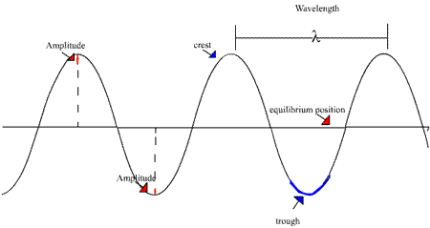
III. Types of waves
Transverse Wave
Most kinds of waves are transverse waves. In a transverse wave, as the wave is moving in one direction, it is creating a disturbance in a perpendicular direction.

Slide 7
IV. Speed of a wave
V= d/t
Or you could use the wave equation:
v = λ⋅f
v is the velocity of waves
λ is the wavelength
f is the frequency of the wave.
Frequency is the number of waves that pass a point in 1 sec.
Measured in Hertz (Hz)
f = cycles/time
f = 1/t and t = 1/f (t = period)

Slide 8
Electromagnetic Spectrum
Most wave are transverse waves.
Most do NOT require a medium to travel
Most are on the electromagnetic spectrum
They all go the same speed in space (3.0 x 10⁸ m/s)

Slide 9
V. Wave Behavior
Reflection
When a wave bounces off an object
Refraction
When a wave bends through an object because the speed changes
Diffraction
When waves bend around an object
Interference
When 2 or more waves add together to form a new one
Constructive (In Phase)
Destructive (180◦ out of phase)

