Slide 1
SOUND
A different kind of wave

Slide 2
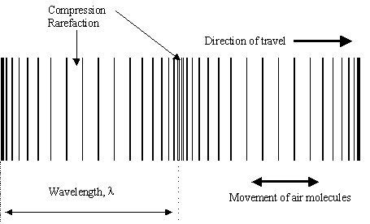
I. Longitudinal waves
The wave’s motion and the disturbance are parallel to each other
Must have a medium
Sound
All other behaviors apply

Slide 3
II. Speed of sound
Same equations as before
Denser the medium, the faster the speed
Hotter the temperature the faster the speed
Speed of sound in air = 331 + .6(T)
T is temperature in Celsius

Slide 4
III. Perceiving sound
Pitch
What we hear
Depends on frequency
Higher the f , the higher the pitch.
Loudness
Also called intensity or volume
Measured in dB (decibels)
Decibels grow exponentially

Slide 5
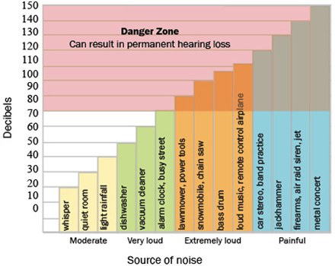
decibels

Slide 6
IV. Doppler Effect
As an object moves, the frequency given off by an object changes.
Towards – frequency gets higher
Away – frequency gets lower
Uses
RADAR
Weather
stars

Slide 7
V. Properties of sound
Reflection
Echo
Amphitheater/parabolic microphones
MACH
How many times the speed of sound an object goes
Breaking the sound barrier

